Slide 1
Tyndale Information Technology

Slide 2
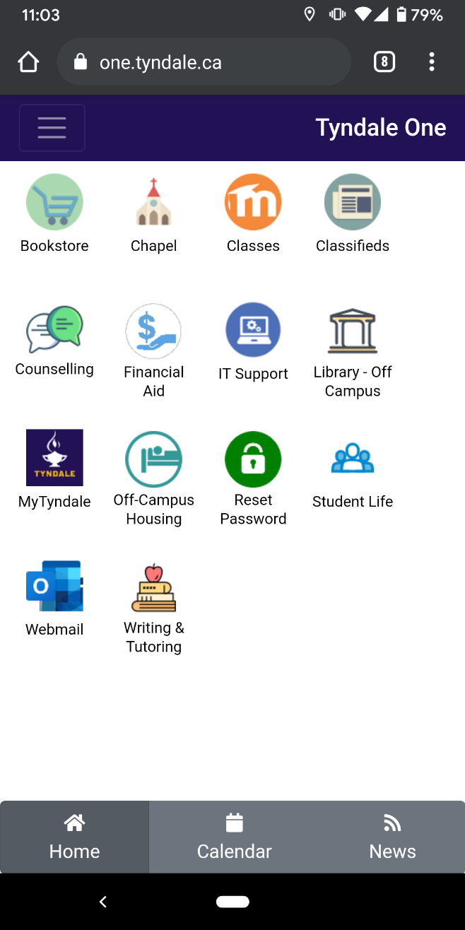
one.tyndale.ca
one.tyndale.ca is the portal used to access many services from Tyndale including but not limited to:
mytyndale.ca
classes.tyndale.ca
webmail.tyndale.ca
helpdesk.tyndale.ca
tyndale.ca/it
And many more

Slide 3
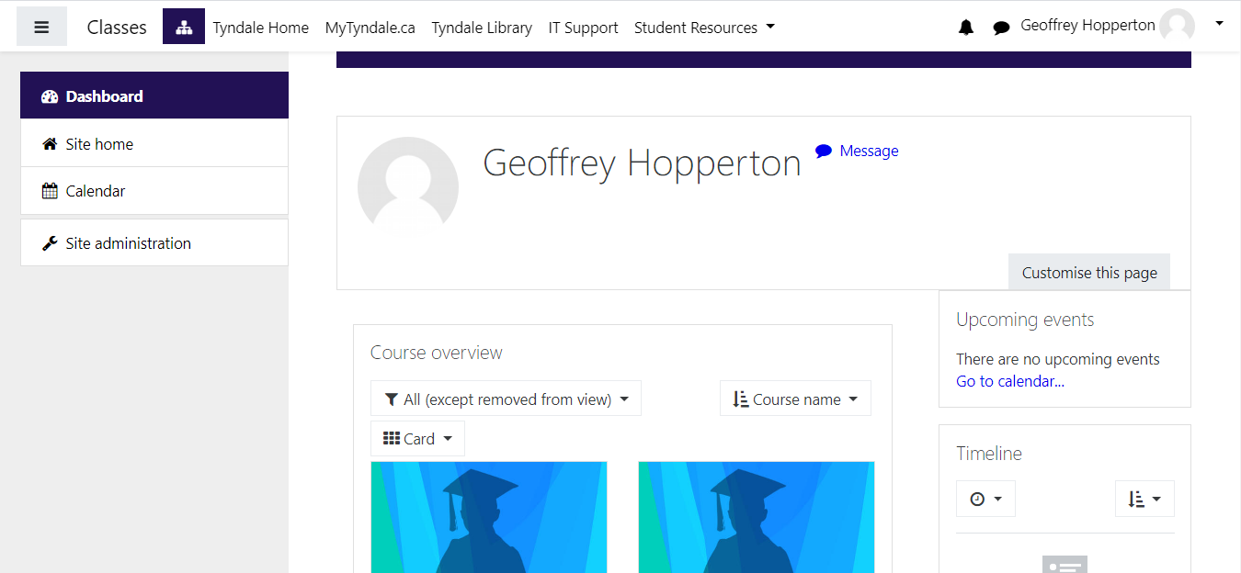
classes.tyndale.ca
All course materials
Syllabus
Readings
Assignments
Forums / Discussions
Grades (Quizzes, assignments)

Slide 4
mytyndale.ca
mytyndale.ca is the centralized Student Portal
Register for courses
Financial Services (Account Statement)
Final Grades
Unofficial Transcript
T2202 tax receipt

Slide 6
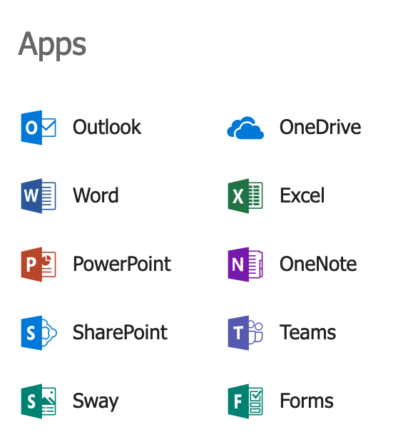
Office 365
Tyndale provides all students with a Microsoft Office 365 Account
@MyTyndale.ca e-mail (webmail.mytyndale.ca)
Online file storage via OneDrive (1TB)
Online/Install applications, including Word, Excel, Powerpoint, OneNote
50 GB of email storage

Slide 7
helpdesk.tyndale.ca

Slide 8
Microsoft Teams and Zoom
Teams and Zoom will be used at the discretion of your professor, you can log into Teams at Teams.Microsoft.com and Zoom at Zoom.us

Slide 9
Microsoft Teams
Your class

Slide 10
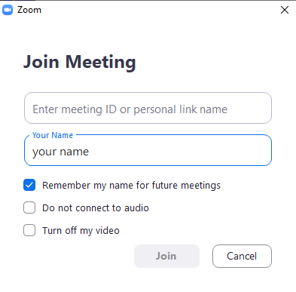
Zoom

Slide 11
Contact Us
E-mail: StudentITHelp@Tyndale.ca
Phone: 416.226.6620 x4357 (HELP)
Website: www.tyndale.ca/it
Helpdesk: www.helpdesk.tyndale.ca

Slide 12
https://www.tyndale.ca/it/resources-for-students/getting-started

